Slide 1
ADVERSARIAL ML FORENSICS
Archana Sreekumar
AM.EN.P2CSN18005

Slide 2
CONTENTS
What is machine learning ?
Adversarial machine learning
IDS with ML
Adversarial attack on IDS
Classifier model
Advesarial attack
Adversarial examples
How does it work?
Classifying the attacks

Slide 3
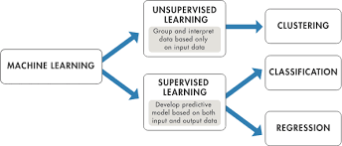
What is Machine Learning??
Field of study that provides systems the ability to automatically learn and improve from experience without being explicitly programmed.
Make use of some training input data to make predictions or decisions to perform a task.
Supervised and un-supervised learning

Slide 4
Adversarial Machine learning
Adversarial Examples : An input that has been manipulated so that the model returns a different, incorrect output.
ML model can be targeted either at ‘learning phase’ or ‘inference phase’ .
To break a model attacker can compromise its confidentiality, integrity, or availability.
Confidentiality : Malicious person cannot examine a model and recover private medical data regarding the patients who helped to train the model.
Integrity : Spammers try to design their e-mail messages to be incorrectly recognized as legitimate messages.
Availability : A self-driving car might be forced to go into a off mode and pull over if an adversary placed an extremely confusing object next to the road ahead of a car.

Slide 5
Adversarial Examples
Small perturbations added to the input image in order to fool the model and misclassify it.
These perturbations are very slight and often indistinguishable to humans.
But force machine learning models to produce wrong predictions.

Slide 6
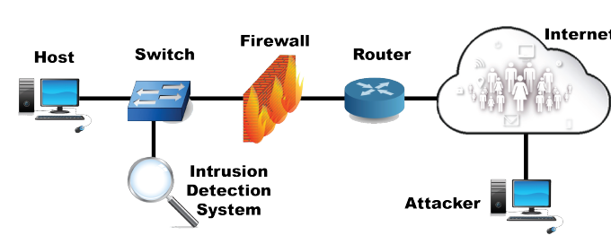
IDS with ML
ML is widely used in intrusion detection
Tradeoff between optimization and security

Slide 7
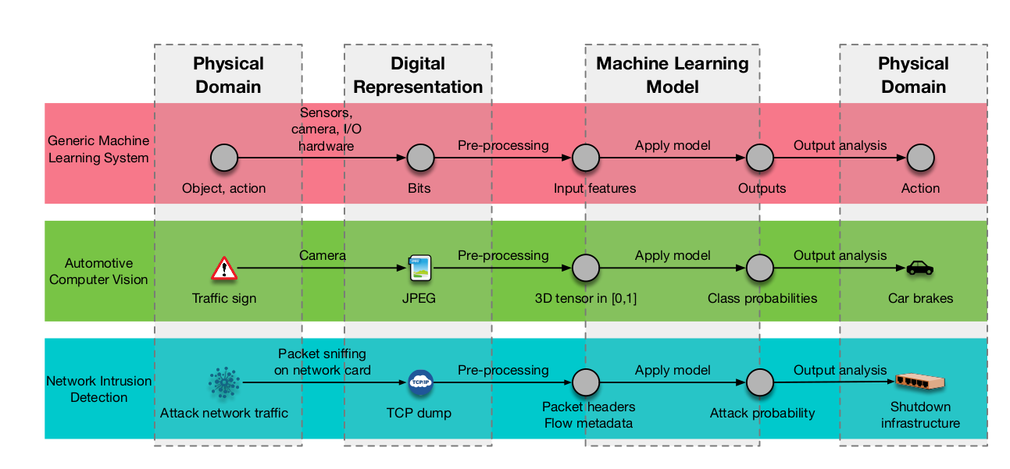
Adversarial ML attack on IDS & classifier
Input features from sensor
Digital processing by model
Adversary can modify data, processing, corrupt model & tamper output

Slide 8
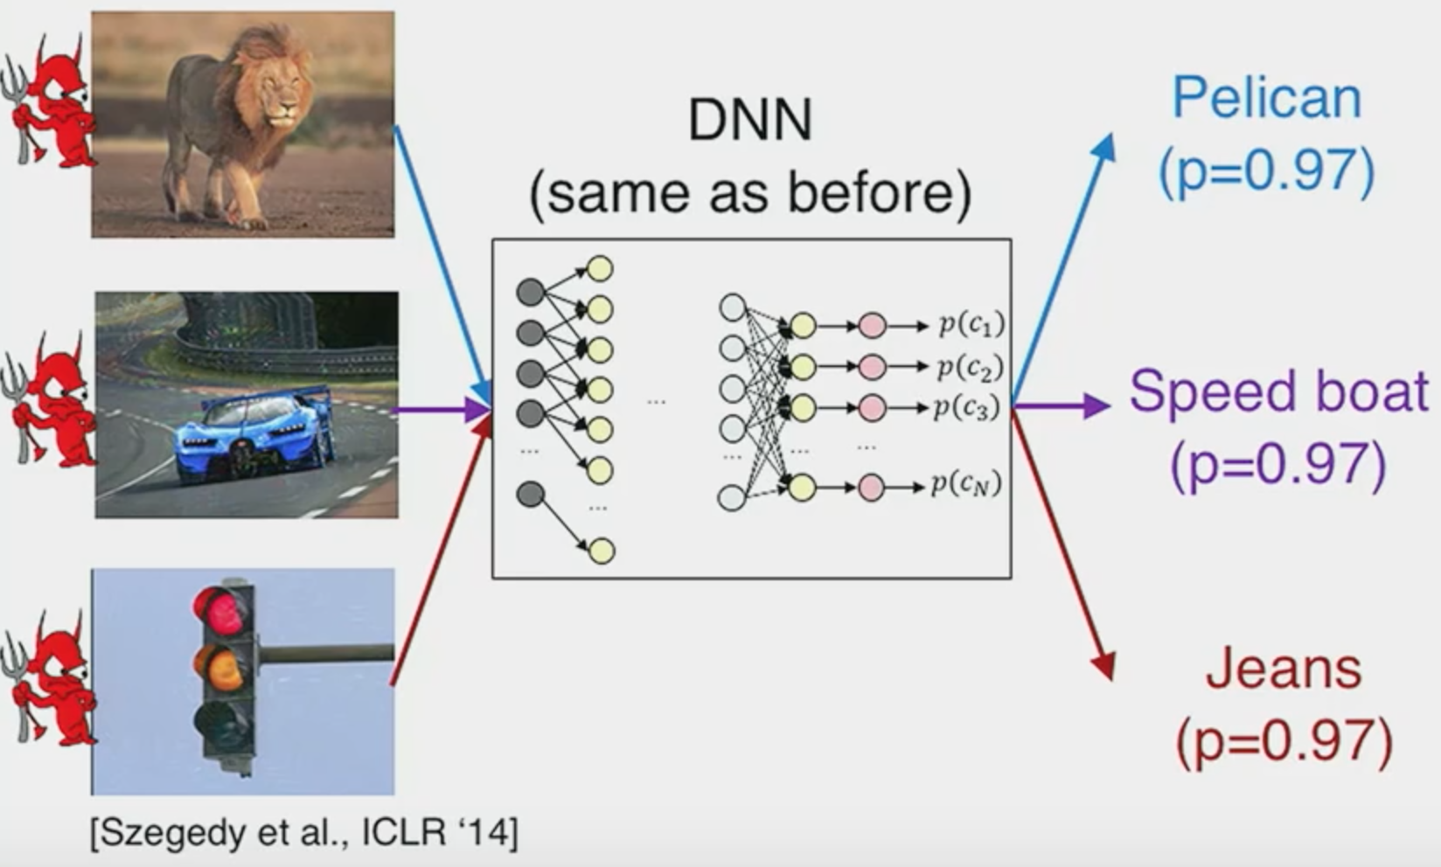
Adversarial Attack

Slide 9
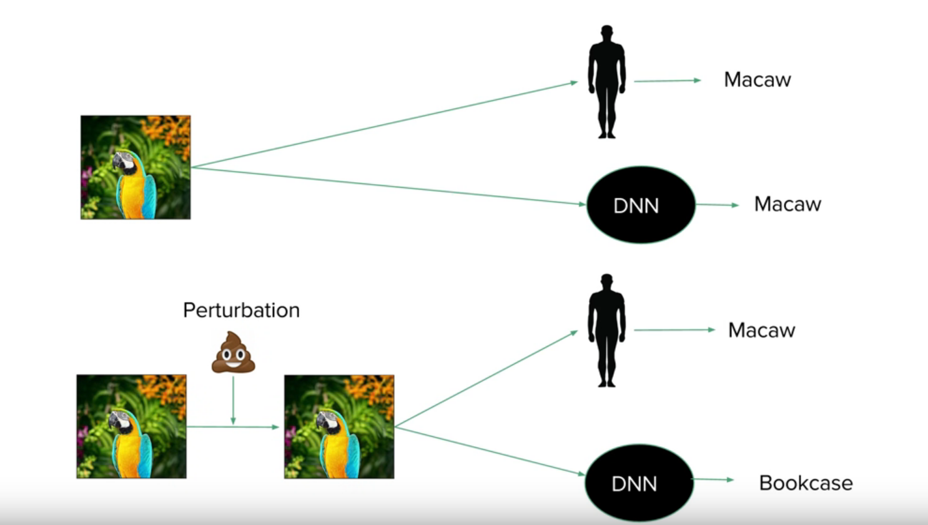
What does a model see?

Slide 10



What would be the result?
Small adversarial perturbation

Slide 11
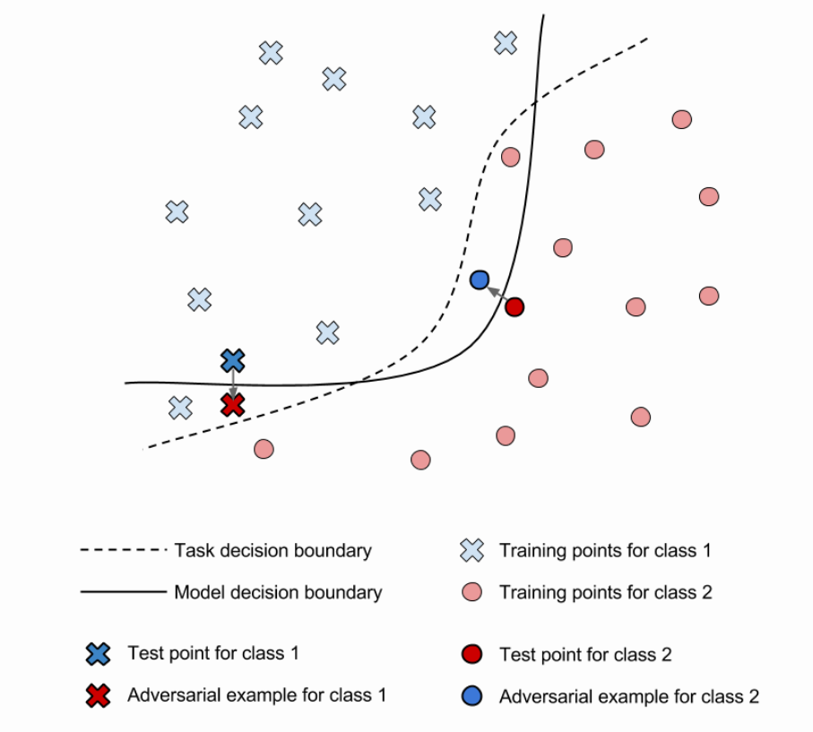
How it works?

Slide 12
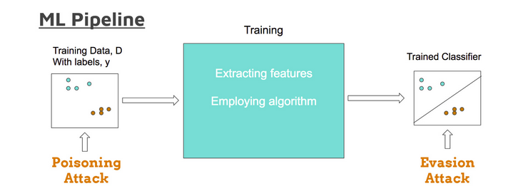
Classifying Attacks
Attack Method:
Poisoning attack: Adversary adds carefully-crafted samples into the training data, thereby disrupting the learning process and manipulating the final trained model.
Evasion attack: When a sample originally correctly classified into class A is manipulated and fed back into the model, now receiving an output that is not class A.

Slide 13
Classifying Attacks
Goal of attack:
Untargeted attack - Also called Error-generic attack
- Attacks aim to find a sample close to a given seed that is misclassified, but do not have a specific target output class.
Targeted attack - Also called Error-specific attack
- Deliberately change the sample’s classification from the original class A to a chosen class B.

Slide 14
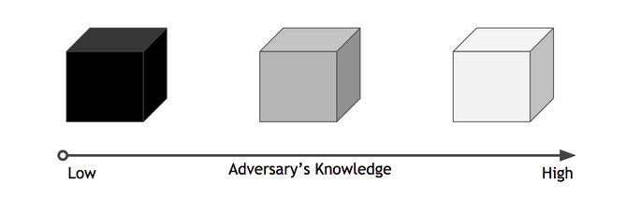
Classifying Attacks
Adversary knowledge:
Black box - Lowest level of adversary knowledge
White box - Attacker knows everything about the model
Grey box - Adversary who knows more about the model than a black box but less than a white box

Slide 15
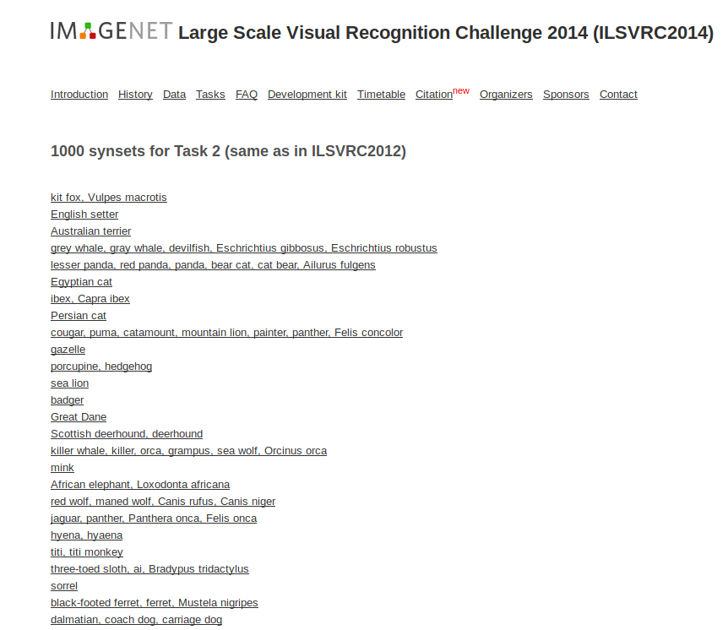
ImageNet database

Slide 16
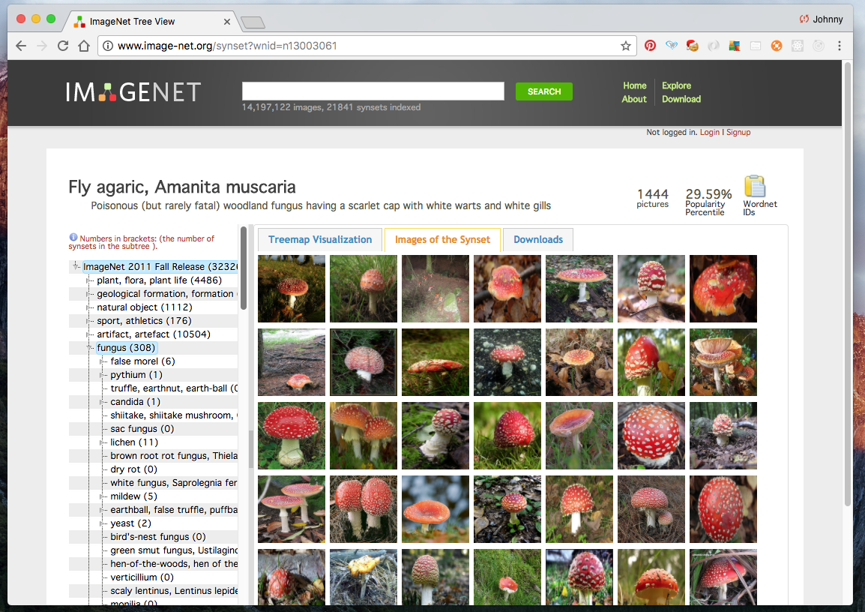
ImageNet database

Slide 17
Reference
https://secml.github.io/class1/
http://www.cleverhans.io/security/privacy/ml/2016/12/16/breaking-things-is-easy.html
http://www.iangoodfellow.com/

